Slide 1
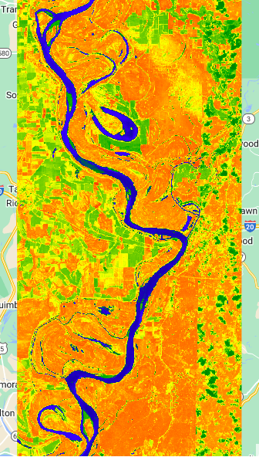
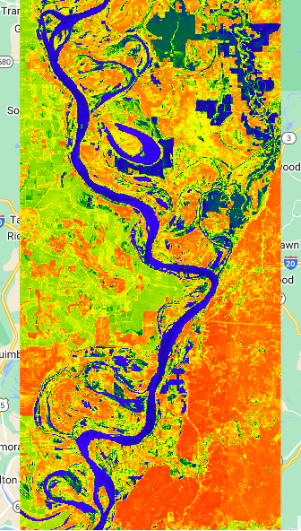
Dry and Wet Season NDWI Images for Mississippi River at Vicksburg, MS

Slide 2
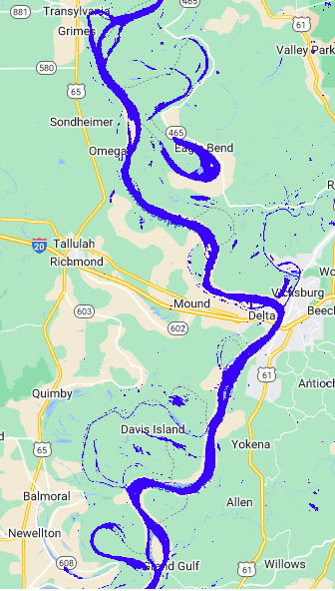
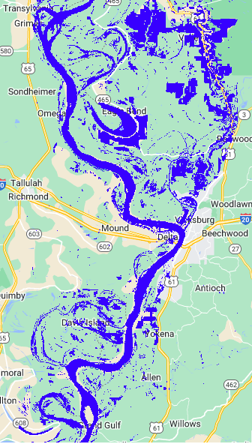
Dry and Wet Season Water Map Images for Mississippi River at Vicksburg, MS

Slide 3
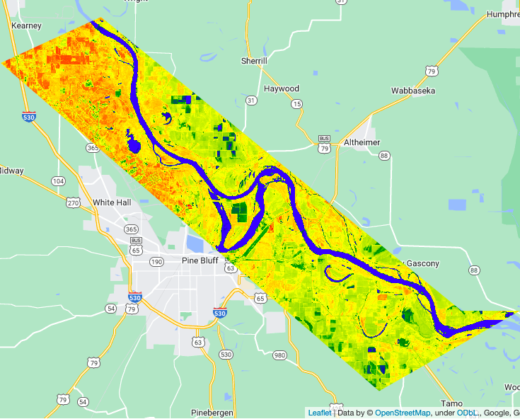
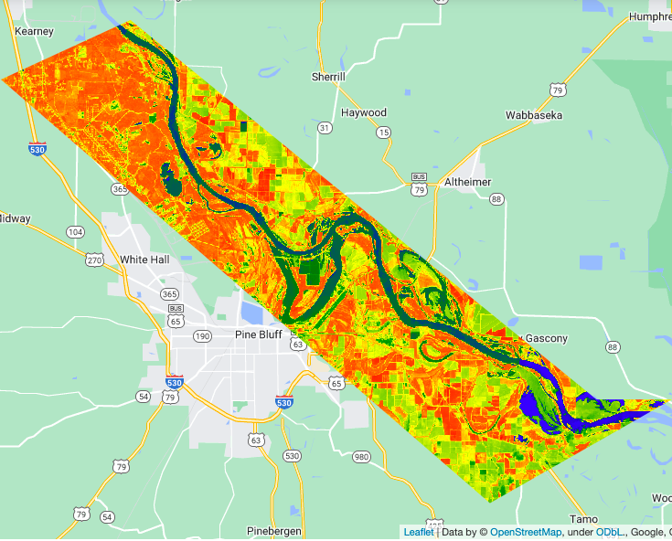
Dry and Wet Season NDWI Images for Arkansas River at Pine Bluff, AR

Slide 4
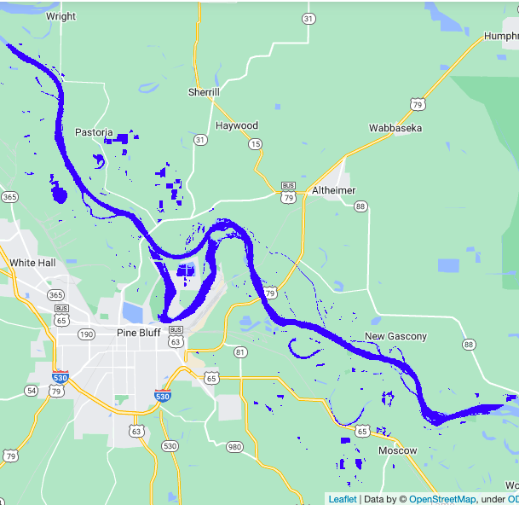
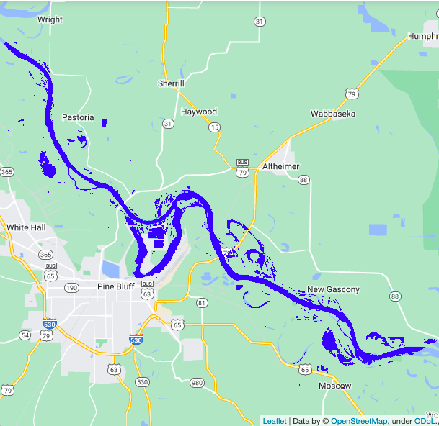
Dry and Wet Season Water Map Images for Arkansas River at Pine Bluff, AR

